Slide 1


Name : Heet Shah
Date : 25-0-2023

Slide 2

Outline
Executive Summary
Introduction
Methodology
Results
Conclusion

Slide 3
Executive Summary
Summary of methodologies
Data collection
Data wrangling
EDA with data visualization
EDA with SQL
Building an interactive map with folium
Building a Dashboard with Plotly Dash
Predictive analysis(Classification)
Summary of all results
EDA results
Interactive analytics
Predictive analysis

Slide 4
Introduction
Project background and context
SpaceX advertise Falcon 9 rocket launches on its websites, with a cost of 62 million dollars; other providers cost upwards of 165 million dollars each, much of the savings is because SpaceX can reuse the first stage.
Problems you want to find answers
The project task is to predicting if the first stage of SpaceX Falcon 9 rocket will land successfully.

Slide 5

Section 1

Slide 6
Methodology
Executive Summary
Data collection methodology:
SpaceX Rest API
Web Scrapping from Wikipedia
Perform data wrangling
One Hot Encoding data fields for machine learning and data cleaning of null values and irrelevant columns.
Perform exploratory data analysis (EDA) using visualization and SQL
Perform interactive visual analytics using Folium and Plotly Dash
Perform predictive analysis using classification models
LR, KNN, SVM, DT models have been build and evaluated for the best classifier

Slide 7
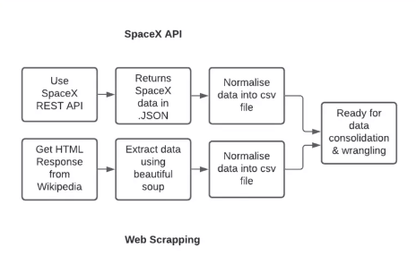
Data Collection
Describe how data sets were collected.
SpaceX Launch data is gathered from SpaceX REST API
This API will give data about launches, including information about rocket used, payload delivered, launch specifications, landing specifications and landing outcome.
The SpaceX REST API endpoints , or URLS starts with api.spacexdata.com/v4/
Another popular data source for Falcon 9 Launch data is web scrapping Wikipedia.

Slide 8
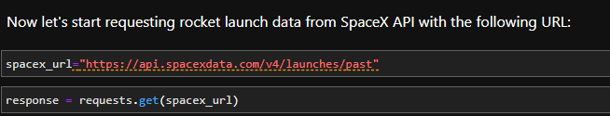
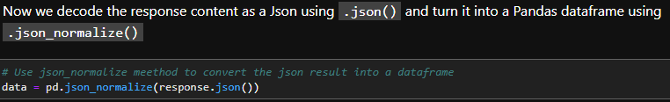
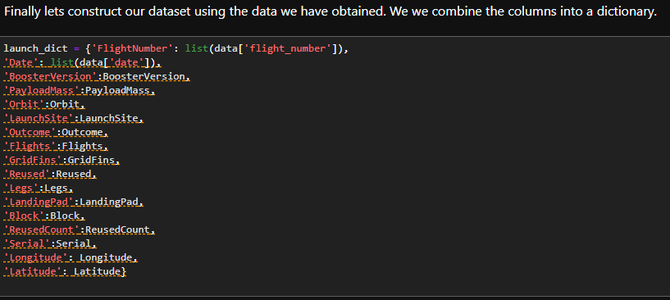
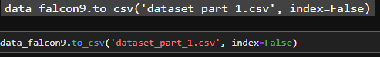
Data Collection – SpaceX API
Place your flowchart of SpaceX API calls here
Data collection with SpaceX REST calls
Github Link : https://github.com/Heet09/Heet09--IBM-Data-Science-Capstone-SpaceX

Slide 9
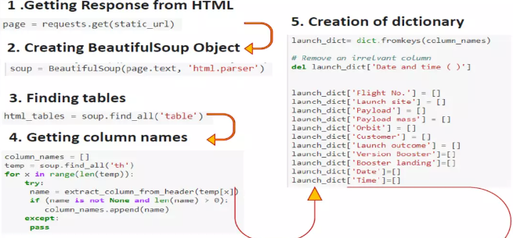
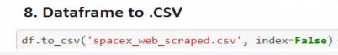
Data Collection - Scraping
Web Scrapping from Wikipedia.
Github Link : https://github.com/Heet09/Heet09--IBM-Data-Science-Capstone-SpaceX
Place your flowchart of web scraping here

Slide 10
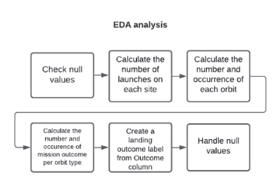
Data Wrangling

Slide 11
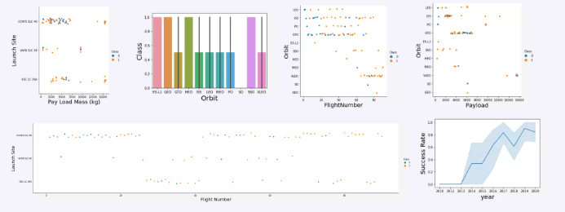
EDA with Data Visualization
Github Link : https://github.com/Heet09/Heet09--IBM-Data-Science-Capstone-SpaceX

Slide 12
EDA with SQL
SQL Queries performed include:
Displaying the names of unique launches in Space mission
Displaying 5 records where launch sites begin with string ‘KSC’
Displaying total payload mass carried by boosters launched by NASA (CRS)
Displaying average payload mass carried by boosters version F9 v1.1
Listing the date when the successful landing outcome in drone ship was achieved.
Listing the names of the boosters which have success in ground pad and have payload mass greater than 4000 but less than 6000.
Listing the total number of successful and failure mission outcomes
Listing the names of the booster_versions which have carried the maximum payload mass. Use a subquery
Listing the records which will display the month names, failure landing_outcomes in drone ship ,booster versions, launch_site for the months in year 2015
Ranking the count of successful landing_outcomes between the date 04-06-2010 and 20-03-2017 in descending order
Github Link : https://github.com/Heet09/Heet09--IBM-Data-Science-Capstone-SpaceX

Slide 13
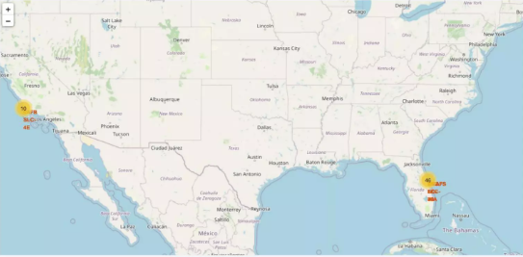
Build an Interactive Map with Folium
Github Link : https://github.com/Heet09/Heet09--IBM-Data-Science-Capstone-SpaceX

Slide 14
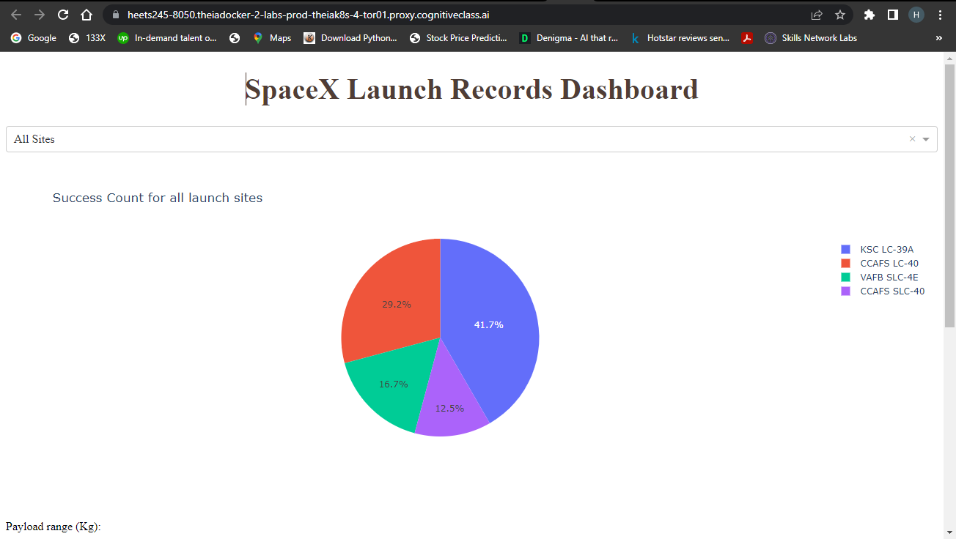
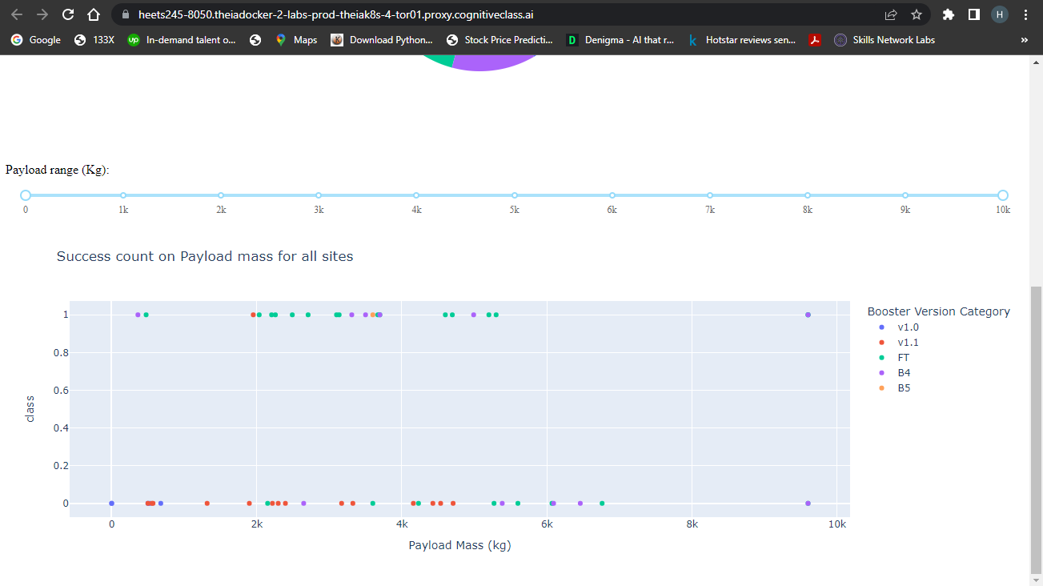
Build a Dashboard with Plotly Dash
Github link: https://github.com/Heet09/Heet09--IBM-Data-Science-Capstone-SpaceX

Slide 15
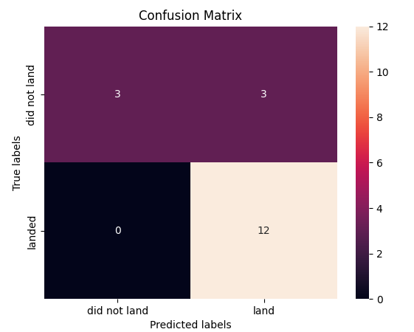
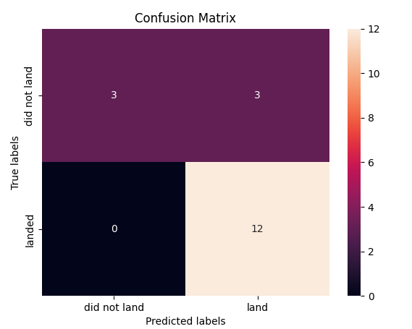
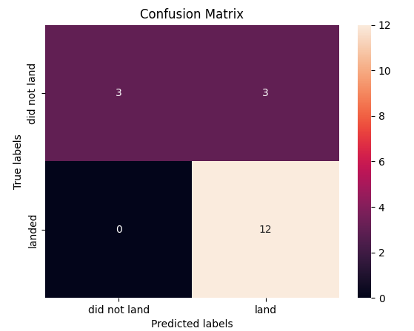
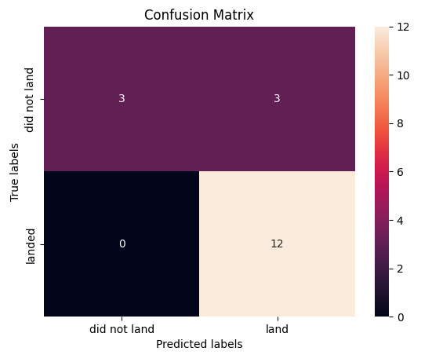
Predictive Analysis (Classification)
LR SVM Decision Tree KNN
The LR, SVM and KNN model achieved the highest accuracy at 83.3% while the SVM performs the best in terms of Area under the curve at 0.958.
Add the GitHub URL : https://github.com/Heet09/Heet09--IBM-Data-Science-Capstone-SpaceX

Slide 16
Results
The SVM, KNN and LR models are the best in terms of prediction accuracy of dataset.
Low Weighted payloads perform better than heavy ones.
The success rate of SpaceX launches is directly proportional time in years they will eventually perfect the launches.
KSC LC 39A has most successful launches from all sites.

Slide 17

Section 2

Slide 18
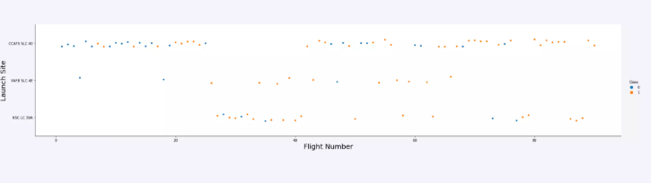
Flight Number vs. Launch Site
Launches from the site KSC LC-39A are significantly lower than the other launches

Slide 19
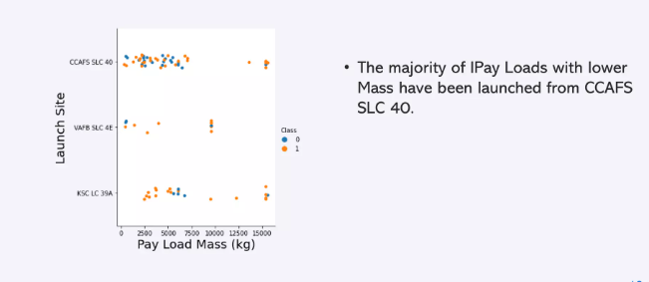
Payload vs. Launch Site
The average IPay loads with lower mass have been launched from VAFB SLC 4E

Slide 20
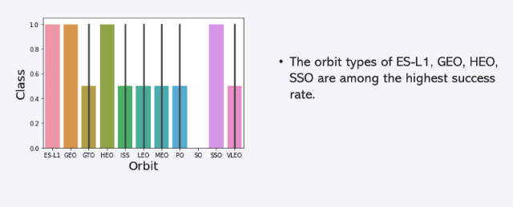
Success Rate vs. Orbit Type

Slide 21
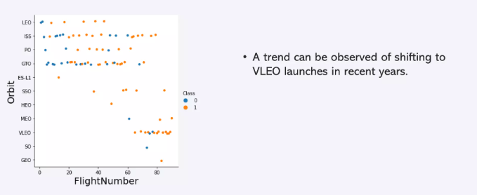
Flight Number vs. Orbit Type
Earlier LEO, ISS and GTO launches had max flight numbers but in recent years trend shifted to VLEO launches.

Slide 22
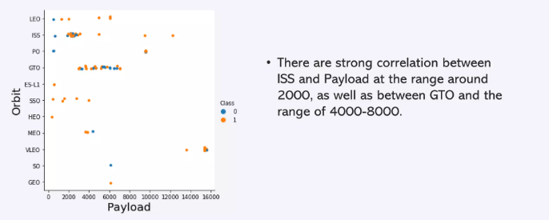
Payload vs. Orbit Type
There are strong correlation between ISS and Payload at the range around 2000, as well as GTO has in range between 2000 to 8000.

Slide 23
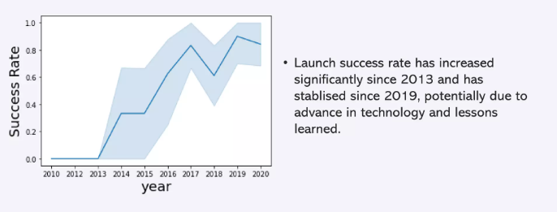
Launch Success Yearly Trend

Slide 24
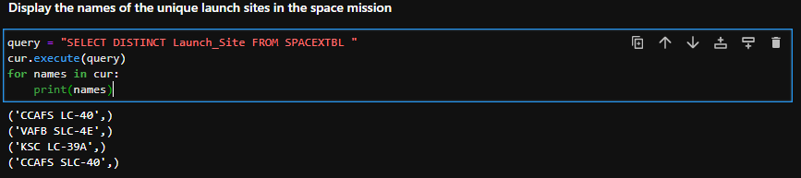
All Unique Launch Site Names

Slide 25
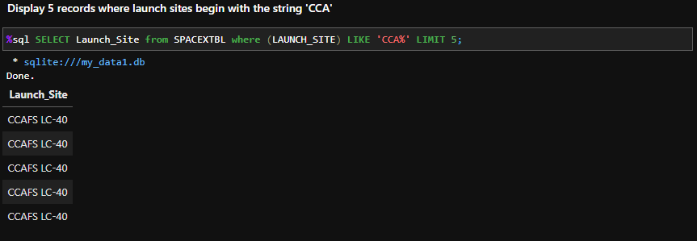
Launch Site Names Begin with 'CCA'

Slide 26
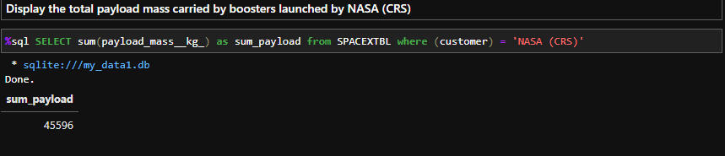
Total Payload Mass

Slide 27
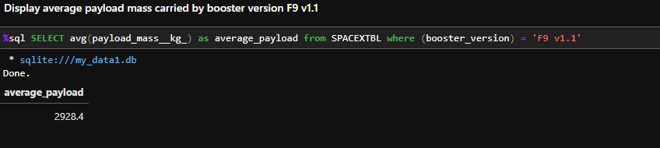
Average Payload Mass by F9 v1.1

Slide 28
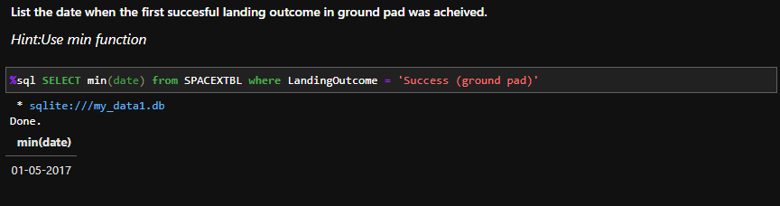
First Successful Ground Landing Date

Slide 29
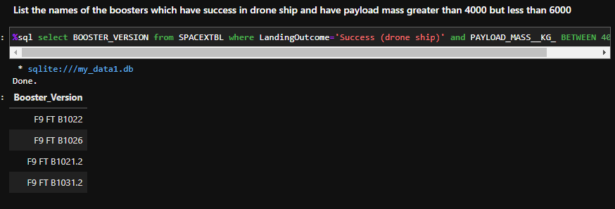
Successful Drone Ship Landing with Payload between 4000 and 6000
%sql select BOOSTER_VERSION from SPACEXTBL where LandingOutcome='Success (drone ship)' and PAYLOAD_MASS__KG_ BETWEEN 4001 and 5999

Slide 30
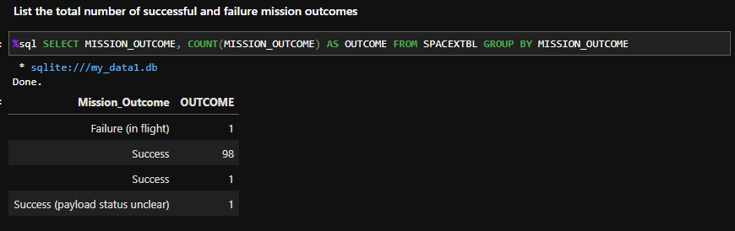
Total Number of Successful and Failure Mission Outcomes

Slide 31
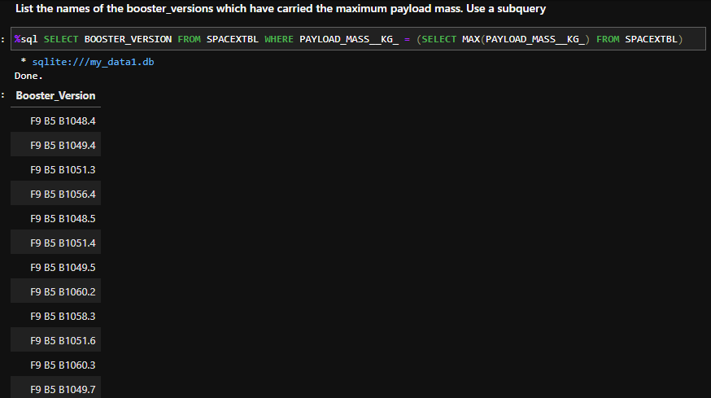
Boosters Carried Maximum Payload

Slide 32
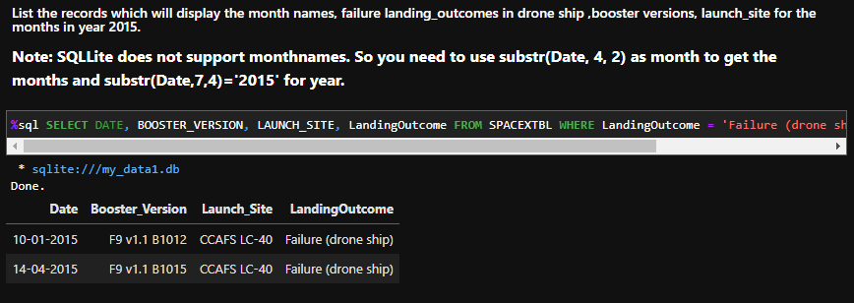
2015 Launch Records
%sql SELECT DATE, BOOSTER_VERSION, LAUNCH_SITE, LandingOutcome FROM SPACEXTBL WHERE LandingOutcome = 'Failure (drone ship)' and substr(Date,7,4)='2015'

Slide 33
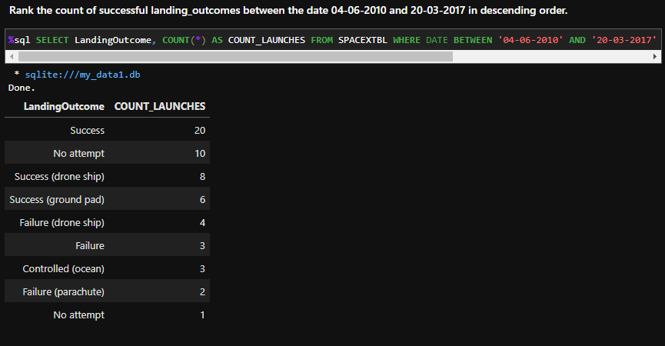
Rank Landing Outcomes Between 2010-06-04 and 2017-03-20
%sql SELECT LandingOutcome, COUNT(*) AS COUNT_LAUNCHES FROM SPACEXTBL WHERE DATE BETWEEN '04-06-2010' AND '20-03-2017' GROUP BY LandingOutcome ORDER BY COUNT_LAUNCHES DESC;

Slide 34

Section 3

Slide 35
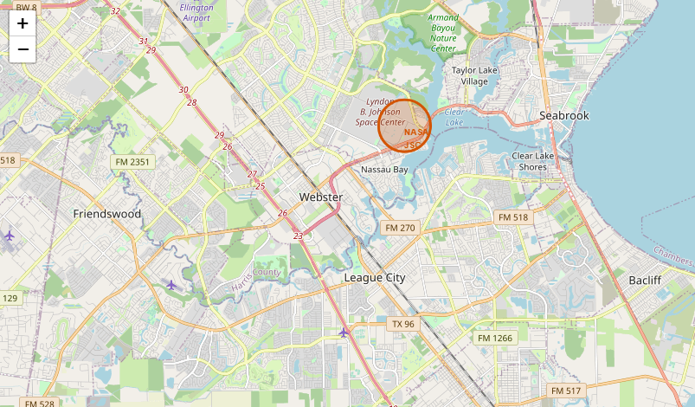
All launch sites marked on map

Slide 36
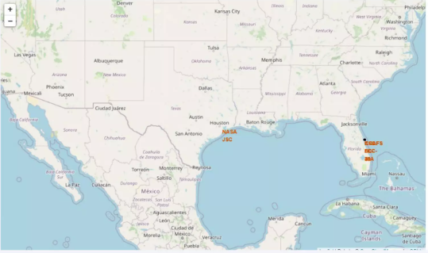
Success/failed launches marked on map

Slide 37
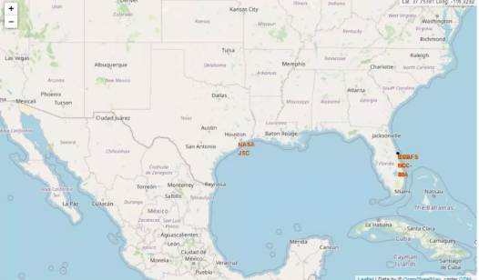
Distance between launch sites and its proximities

Slide 38

Section 4

Slide 39
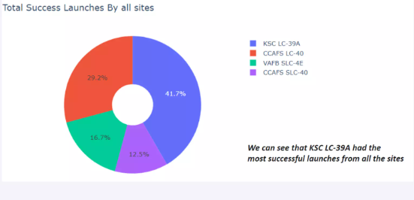
Total success launches by all sites

Slide 40
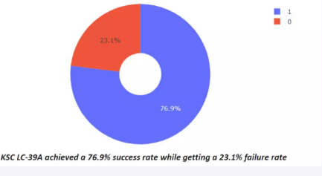
Success rate by sites

Slide 41
Success count on Payload mass of all sites

Slide 42

Section 5

Slide 43
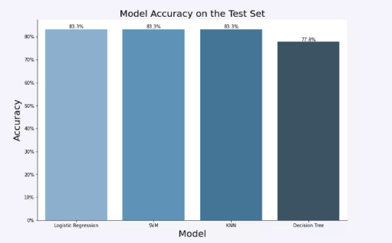
Classification Accuracy

Slide 44
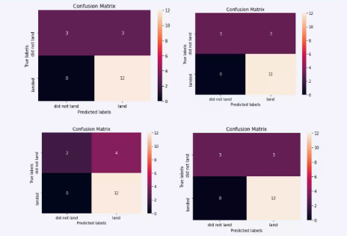
Confusion Matrix

Slide 45
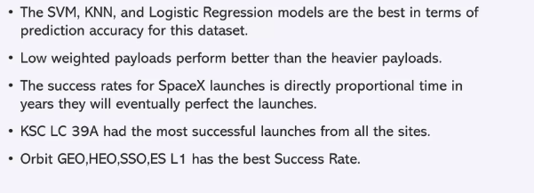
Conclusions

Slide 46


